Slide 1

Introduction to Rust
Please follow these instructions to get set up:
github.com/rtfeldman/rust-1.51-workshop
Notes:
This work is licensed under a Creative Commons Attribution 4.0 International License. Enjoy!
Created by Richard Feldman, author of Elm in Action. This talk explains the methodology behind this workshop's design: https://youtu.be/G-GhUxeYc1U

Slide 2
Introduction
What is Rust?
Who uses Rust?
Why & why not use Rust?
Workshop Structure

Slide 3
rust-lang.org
“ A language empowering everyone to build reliable and efficient software.”

Slide 4

machine code
0111010110101100111101101101011001001011
Rust
compiles to either
Notes:
Elm is a functional programming language that compiles to JavaScript.

Slide 5






Who uses Rust?
More at rust-lang.org/production
Notes:
So this is a different language with different syntax...what's the benefit? Or, in more tangible terms: why should my boss let me use this at work? On the nontechnical side, there are more people who want an Elm job than there are Elm jobs. But let's talk technical benefits: first with a specific example, then looking at the big picture.

Slide 6
What can I build with Rust?
Web servers
Command-Line Interfaces
Native desktop applications
In-browser apps via WebAssembly
https://makepad.dev
Performance-intensive libraries
Operating systems (!)
Notes:
So this is a different language with different syntax...what's the benefit? Or, in more tangible terms: why should my boss let me use this at work? On the nontechnical side, there are more people who want an Elm job than there are Elm jobs. But let's talk technical benefits: first with a specific example, then looking at the big picture.

Slide 7
Why use Rust?
Speed
Performance
Going Real Fast
Notes:
So this is a different language with different syntax...what's the benefit? Or, in more tangible terms: why should my boss let me use this at work? On the nontechnical side, there are more people who want an Elm job than there are Elm jobs. But let's talk technical benefits: first with a specific example, then looking at the big picture.

Slide 8
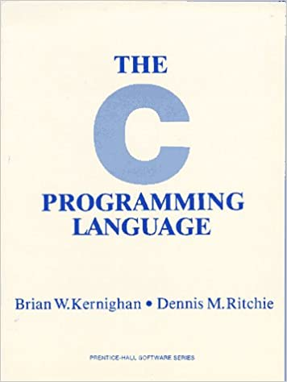
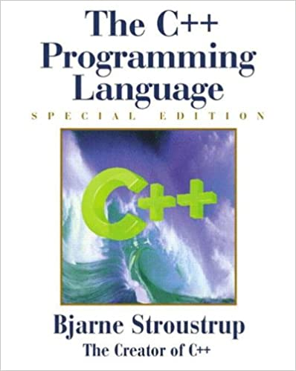
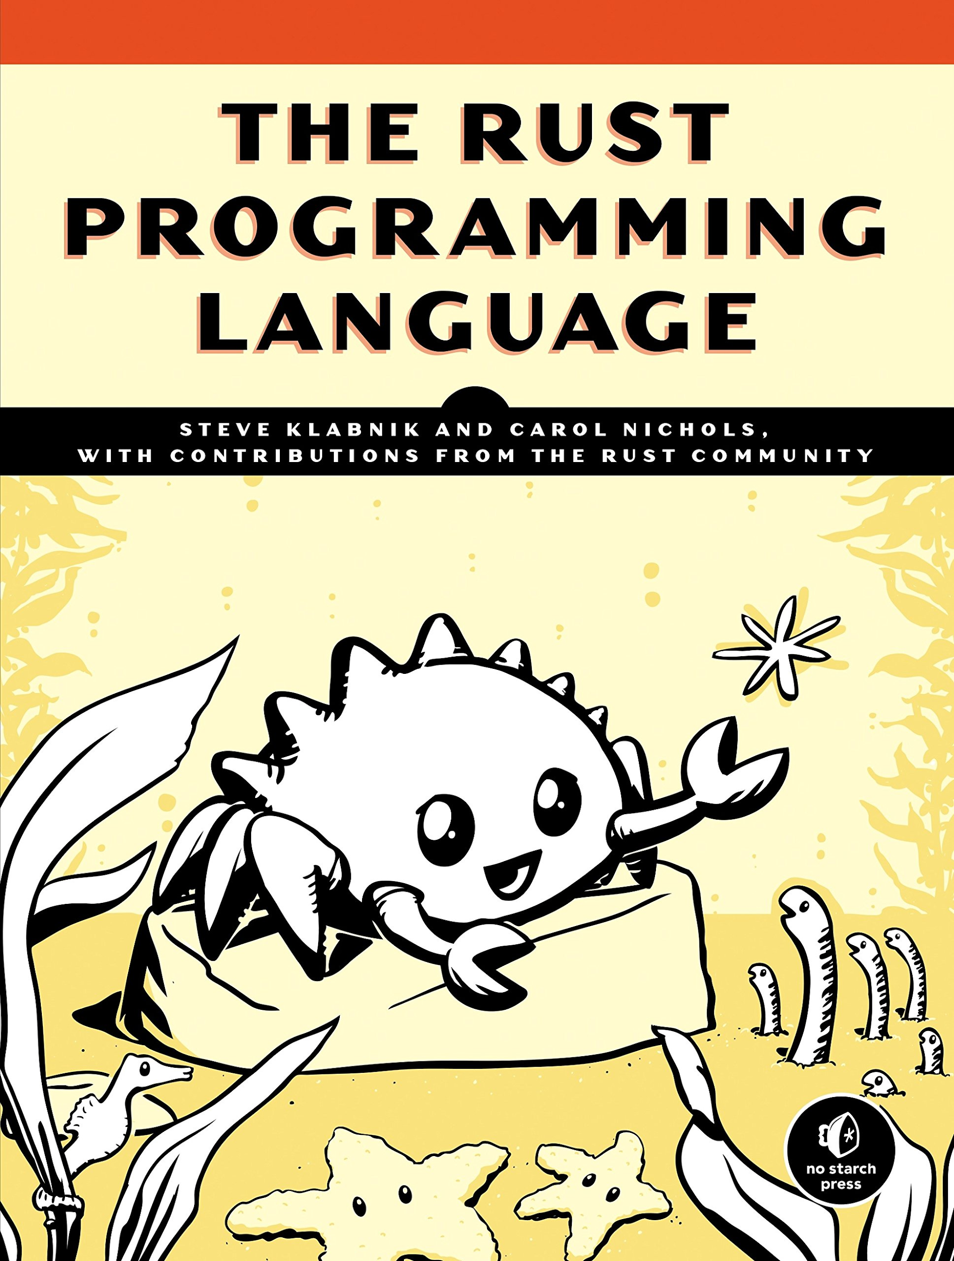
1972
1985
2010
efficient
efficient
OOP
efficient
reliable
ergonomic

Slide 9
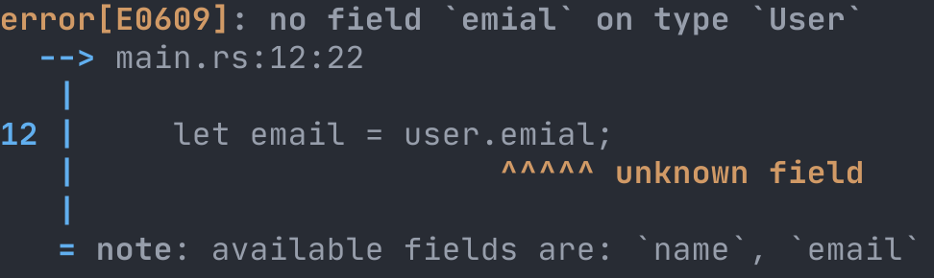

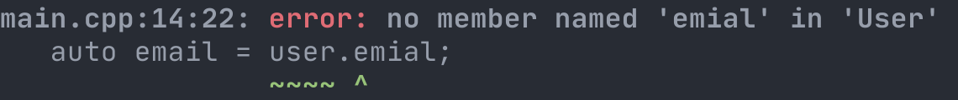
Why use Rust?
Notes:
So this is a different language with different syntax...what's the benefit? Or, in more tangible terms: why should my boss let me use this at work? On the nontechnical side, there are more people who want an Elm job than there are Elm jobs. But let's talk technical benefits: first with a specific example, then looking at the big picture.

Slide 10

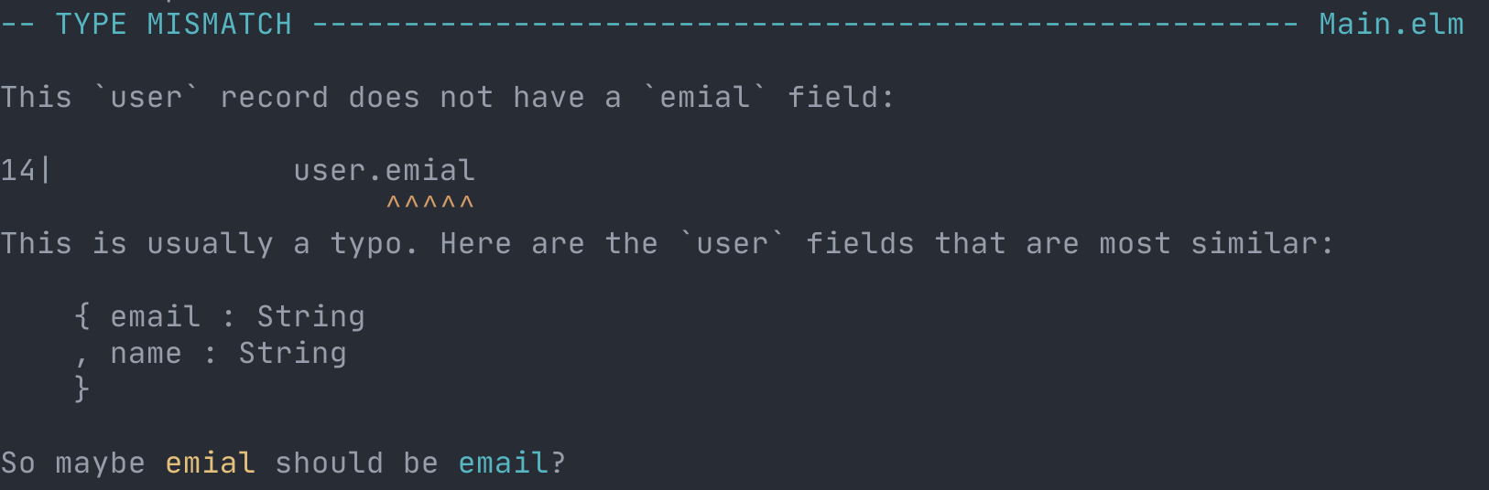
elm-lang.org
Notes:
So this is a different language with different syntax...what's the benefit? Or, in more tangible terms: why should my boss let me use this at work? On the nontechnical side, there are more people who want an Elm job than there are Elm jobs. But let's talk technical benefits: first with a specific example, then looking at the big picture.

Slide 11
Notes:
So this is a different language with different syntax...what's the benefit? Or, in more tangible terms: why should my boss let me use this at work? On the nontechnical side, there are more people who want an Elm job than there are Elm jobs. But let's talk technical benefits: first with a specific example, then looking at the big picture.

Slide 12
Why use Rust?
C/C++ level performance, with…
...nice ergonomics and a language server
...automatic memory management
...a package manager and code formatter
...more compiler help with concurrency
...lots of compiler help for big code bases
Notes:
So this is a different language with different syntax...what's the benefit? Or, in more tangible terms: why should my boss let me use this at work? On the nontechnical side, there are more people who want an Elm job than there are Elm jobs. But let's talk technical benefits: first with a specific example, then looking at the big picture.

Slide 13
Why not use Rust?
Rust is a big language - lots to learn!
smaller ecosystem than C/C++ (but FFI)
slower iteration cycle than most languages
strict compiler
satisfying (“fighting”) the borrow checker
slow compile times for full builds
tests can take awhile to build
safer than C++, less safe than e.g. pure FP
Notes:
So this is a different language with different syntax...what's the benefit? Or, in more tangible terms: why should my boss let me use this at work? On the nontechnical side, there are more people who want an Elm job than there are Elm jobs. But let's talk technical benefits: first with a specific example, then looking at the big picture.

Slide 14


“most loved programming language”
2016 - Rust
2017 - Rust
2018 - Rust
2019 - Rust
2020 - Rust
Notes:
So this is a different language with different syntax...what's the benefit? Or, in more tangible terms: why should my boss let me use this at work? On the nontechnical side, there are more people who want an Elm job than there are Elm jobs. But let's talk technical benefits: first with a specific example, then looking at the big picture.

Slide 15
Workshop Structure
7 sections
30-40 minutes of slides (please ask questions!)
15-20 minutes of exercises (and solutions)
1 hour break for lunch
2-3 additional 10-15 minute breaks

Slide 16
Recap
What is Rust?
Who uses Rust?
Why & why not use Rust?
Workshop Structure

Slide 17
1. Primitives
strings
floats
integers
booleans

Slide 18
Hello, World!
app.rs
fn main() {
println!("Hello, World!");
}
rustc app.rs

Slide 19
String Interpolation
fn main() {
let greeting = "Hello";
let subject = "World";
println!("{}, {}!", greeting, subject);
}
Hello, World!

Slide 20
String Interpolation
let subject = "World";
let greeting = format!("Hello, {}!", subject);
fn main() {
let crash_reason = "Server wanted a nap.";
panic!("I crashed! {}", crash_reason);
println!("This will never get run.");
}

Slide 21
Floats
fn main() {
let x = 1.1;
let y = 2.2;
println!("x times y is {}", x * y);
}
x times y is 2.4200000000000004

Slide 22
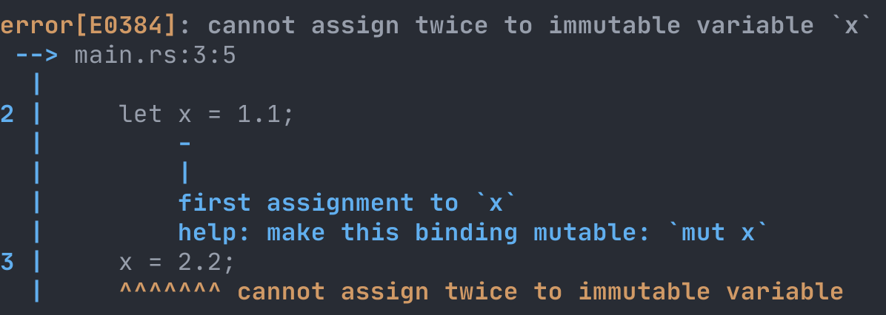
Mutability
✓
let x = 1.1;
x = 2.2;
let mut x = 1.1;
x = 2.2;

Slide 23
Numeric Types
let mut y = 2.2;
y = 3.1;
y = "three point one";
y changed types!

Slide 24
Type Annotations
fn main() {
let x = 1.1; // x is a float
let y = 2.2;
println!("x times y is {}", x * y);
}

Slide 25
Type Annotations
fn main() {
let x: f64 = 1.1;
let y = 2.2;
println!("x times y is {}", x * y);
}

Slide 26
Type Annotations
“main takes no arguments and returns nothing”
fn main() {
let answer = multiply_both(1.1, 2.2);
println!("1.1 × 2.2 = ", answer);
}
! means println is a macro, not a function
“multiply_both takes two f64 arguments and returns an f64”
fn multiply_both(x: f64, y: f64) -> f64 {
return x * y;
}

Slide 27
Float Sizes
f64 has 64 bits (8 bytes) of storage
let x: f64 = 10.0 / 3.0;
let y: f32 = 10.0 / 3.0;
3.33333333…
f32 has 32 bits (4 bytes) of storage
more memory used allows for more precision
more memory used may slow down the program

Slide 28
Integers
let ninety = 90;
let negative_five = -5;
let one_thousand = 1_000;
let exactly_three = 10 / 3;
let this_will_panic = 5 / 0; // kaboom!

Slide 29
Integer Sizes
i8
i16
i32
i64
i128
8 bits (1B)
16 bits (2B)
32 bits (4B)
64 bits (8B)
128 bits (16B)
-127 to 128
-32,768 to 32,767
…

Slide 30
Unsigned Integers
u8
u16
u32
u64
u128
0-255
0-65,535
0-4,294,967,295
0-18,446,744,073,709,551,615
0-170,141,183,460,469,231,731,687,303,715,884,105,728
char
a u32 that’s been Unicode validated

Slide 31
Converting Numbers with as
fn multiply(x: i64, y: u8) -> i64 {
return x * (y as i64);
}
fn divide(x: i32, y: u16) -> f64 {
return x as f64 / y as f64;
}

Slide 32
Booleans
let should_we_go_fast = true;
let should_we_go_slow = false;
true as u8 // evaluates to 1
false as u8 // evaluates to 0
1 == 2 // evaluates to false

Slide 33
Conditionals
if cats > 1 {
println!("Multiple cats!");
}
else {
println!("Need more cats!");
}

Slide 34
Conditionals
if cats > 1 {
println!("Multiple cats!");
}
else if cats > 1_000 {
println!("Too many cats!");
}

Slide 35
Statements and Expressions
An expression evaluates to a value
cats > 1_000
cats > count_cats(cat_areas)
A statement does not evaluate to a value
println!("Multiple cats!");

Slide 36
Statements and Expressions
fn multiply_both(x: f64, y: f64) -> f64 {
return x * y;
}
expression
statement
fn multiply_both(x: f64, y: f64) -> f64 {
x * y
}
expression
if a function ends with an expression,
it automatically returns that expression

Slide 37
Statements and Expressions
if cats > 1 {
println!("Multiple cats!");
}
else if cats > 1_000 {
println!("Too many cats!");
} else {
println!("Need more cats!");
}

Slide 38
Statements and Expressions
let message = if cats > 1 {
"Multiple cats!"
}
else if cats > 1_000 {
"Too many cats!"
} else {
"Need more cats!"
};

Slide 39
Statements and Expressions
let message = if cats > 1 {
"Multiple cats!"
}
else if cats > 1_000 {
"Too many cats!"
} else {
"Need more cats!"
};

Slide 40
Review of Part 1
strings format!("Hi, {}!", name)
floats let mut float: f64 = 1.234;
integers let one: u32 = 1.99 as u32;
booleans if x > 5 { true } else { false }

Slide 41
Exercises for Part 1
Follow the instructions in part1/README.md

Slide 42
2. Collections
tuples
structs
arrays
memory

Slide 43
Tuples
let point: (i64, i64, i64) = (0, 0, 0);
let x = point.0;
let y = point.1;
let z = point.2;
let (x, y, z) = point;
let (x, y, _) = point;
let (x, _, _) = point;

Slide 44
Tuples
let mut point: (i64, i64, i64) = (0, 0, 0);
point.0 = 17;
point.1 = 42;
point.2 = 90;

Slide 45
Unit
let unit: () = ();
fn main() {
…
}
fn main() -> () {
…
}
let println_return_val: () = println!("Hi!");

Slide 46
Structs
struct Point {
x: i64,
y: i64,
z: i64,
}
fn new_point(x: i64, y: i64, z: i64) -> Point {
Point { x: x, y: y, z: z }
}
fn new_point(x: i64, y: i64, z: i64) -> Point {
Point { x, y, z }
}

Slide 47
Structs
struct Point {
x: i64,
y: i64,
z: i64,
}
let point = Point { x: 1, y: 2, z: 3 };
let x = point.x;
let Point { x, y, z } = point;
let Point { x, y: _, z } = point;
let Point { x, z, .. } = point;
let Point { x, .. } = point;

Slide 48
Structs
struct Point {
x: i64,
y: i64,
z: i64,
}
let mut point = Point { x: 1, y: 2, z: 3 };
point.x = 5;

Slide 49
Arrays
fixed-length
let mut years: [i32; 3] = [1995, 2000, 2005];
let first_year = years[0];
let [_, second_year, third_year] = years;
years[2] = 2010;
years[x] = 2010;
this will panic if it’s out of bounds!
method call
for year in years.iter() {
println!("Next year: {}", year + 1);
}

Slide 50
Arrays vs Tuples
let mut years: [i32; 3] = [1995, 2000, 2005];
i32
for year in years.iter() {
println!("Next year: {}", year + 1);
}

Slide 51
Arrays vs Tuples
Arrays can be iterated over
Tuples (and structs) cannot
Array elements must all have the same type
let years: (i32, i32, bool) =
(1995, 2000, true);
for year in years.iter() {
println!("Next year: {}", year + 1);
}

Slide 52
Memory
bits
1
1
1
1
0
0
1
1
0
1
1
0
1
0
1
1
0
1
…
byte 1: 11110011
byte 2: 01101011
byte 3: …

Slide 53
Memory
bits
1
1
1
1
0
0
1
1
0
1
1
0
1
0
1
1
0
1
…
byte 1: 11110011
byte 2: 01101011
byte 3: …
243

Slide 54
Memory
bits
1
1
1
1
0
0
1
1
0
1
1
0
1
0
1
1
0
1
…
byte 1: 11110011
byte 2: 01101011
byte 3: …
243
107

Slide 55
Memory
bits
1
1
1
1
0
0
1
1
0
1
1
0
1
0
1
1
0
1
…
243
107
117
5
61
12
134
57
213
…
bytes

Slide 56
Memory
“u8 array”
array[0]
243
107
117
5
61
12
134
57
213
…

Slide 57
Memory
“u8 array”
array[7]
array[8]
array[3]
array[4]
array[5]
…
array[0]
array[1]
array[2]
array[6]
243
107
117
5
61
12
134
57
213
…

Slide 58
Memory
“u16 array”
array[0]
array[1]
array[2]
243
107
117
5
61
12
134
57
213
…
62315
29957
15628

Slide 59
Memory
let array: [u16; 3] = [62315, 29957, 15628];
array[0]
array[1]
array[2]
243
107
117
5
61
12
134
57
213
…
62315
29957
15628

Slide 60
Memory
let array: [u32; 2] = [4083905797, 1024230969];
array[0]
array[1]
243
107
117
5
61
12
134
57
213
…
4083905797
1024230969

Slide 61
Memory
let array: [u16; 3] = [62315, 29957, 15628];
array[0]
array[1]
array[2]
243
107
117
5
61
12
134
57
213
…
62315
29957
15628

Slide 62
Memory
let point: (u16, u16, u16) =
(62315, 29957, 15628);
point.0
point.1
point.2
243
107
117
5
61
12
134
57
213
…
62315
29957
15628

Slide 63
Memory
struct Point { x: u16, y: u16, z: u16 }
let pt: Point = Point {62315, 29957, 15628};
pt.x
pt.y
pt.z
243
107
117
5
61
12
134
57
213
…
62315
29957
15628

Slide 64
Memory
struct Point { x: u16, y: u16, z: u16 }
let point: (u16, u16, u16) =
(62315, 29957, 15628);
let pt: Point = Point {62315, 29957, 15628};
let array: [u16; 3] = [62315, 29957, 15628];
243
107
117
5
61
12
134
57
213
…
62315
29957
15628

Slide 65
Tuples, Structs, Arrays
Arrays can be iterated over
Tuples and structs cannot
Array elements must all have the same type
Tuple and struct fields can be different types
In memory, they’re all represented as adjacent bytes with no extra metadata

Slide 66
Review of Part 2
tuples let foo: (i64, bool) = (1, true);
structs struct Foo { x: i64, is_up: bool }
arrays let arr: [u32; 3] = [1, 2, 3];
memory u8 is 8 bits (1 byte), u16 is 16 bits (2 bytes), …

Slide 67
Exercises for Part 2
Follow the instructions in part2/README.md

Slide 68
3. Pattern Matching
enums
pattern matching
methods
type parameters

Slide 69
Enums
enum Color {
Green,
Yellow,
Red,
}
type
variant
variant
variant
let go = Color::Green;
let stop = Color::Red;
let slow_down = Color::Yellow;
let go: Color = Color::Green;
let stop: Color = Color::Red;
let slow_down: Color = Color::Yellow;

Slide 70
Enums
enum Color {
Green,
Yellow,
Red,
Custom { red: u8, green: u8, blue: u8 }
}
let go: Color = Color::Green;
let stop: Color = Color::Red;
let purple: Color = Color::Custom {
red: 100, green: 0, blue: 250
};

Slide 71
Enums
enum Color {
Green,
Yellow,
Red,
Custom(u8, u8, u8)
}
let purple: Color = Color::Custom(100, 0, 250);

Slide 72
Pattern Matching
let current_color = Color::Yellow;
match current_color {
Color::Green => {
println!("It was green!");
}
Color::Yellow => {
println!("It was yellow!");
}
}

Slide 73
Pattern Matching
match current_color {
Color::Green => {
println!("It was green!");
}
Color::Yellow => {
println!("It was yellow!");
}
Color::Custom { red, green, blue } => {
println!("{} {} {}", red, green, blue);
}
}

Slide 74
Pattern Matching
match current_color {
Color::Green => {
println!("It was green!");
}
Color::Yellow => {
println!("It was yellow!");
}
Color::Custom(red, green, blue) => {
println!("{} {} {}", red, green, blue);
}
}

Slide 75
Pattern Matching
let color_str = match current_color {
Color::Green => {
"It was green!"
}
Color::Yellow => {
"It was yellow!"
}
};

Slide 76
Pattern Matching
let color_str = match current_color {
Color::Green => {
"It was green!"
}
Color::Yellow => {
"It was yellow!"
}
_ => {
"It was something else!"
}
};

Slide 77
Pattern Matching
let some_number = 5;
let number_str = match some_number {
1 => {
"It was one!"
}
2 => {
"It was two!"
}
_ => {
"It was something else!"
}
};

Slide 78
Pattern Matching
let some_number = 5;
let number_str = match some_number {
1 => {
"It was one!"
}
2 => {
"It was two!"
}
_ => {
"It was something else!"
}
};

Slide 79
Methods
enum Color { … }
impl Color {
fn rgb(color: Color) -> (u8, u8, u8) { … }
fn new(r: u8, g: u8, b: u8) -> Color { … }
}
}
let red = Color::new(250, 0, 0);
let purple = Color::new(100, 0, 250);
let (r, g, b) = Color::rgb(purple);

Slide 80
Methods
enum Color { … }
impl Color {
fn rgb(self) -> (u8, u8, u8) { … }
fn new(r: u8, g: u8, b: u8) -> Self { … }
}
}
let purple: Color = Color::new(100, 0, 250);
let (r, g, b) = Color::rgb(purple);
let (r, g, b) = purple.rgb();
same!

Slide 81
Type Parameters
let last_char = my_string.pop();
let last_char: char = my_string.pop();

Slide 82
Type Parameters
let last_char = my_string.pop();
let last_char: Option<char> = my_string.pop();
enum Option<T> {
None,
Some(T),
}
let email: Option<String> = Some(email_str);
let email: Option<String> = None;
(None is Option::None - the prefix is optional for Option)

Slide 83
Type Parameters
enum Result<O, E> {
Ok(O),
Err(E),
}
let success: Result<i64, String> = Ok(42);
let failure: Result<i64, String> = Err(str);
(the Result:: prefix is also optional for Result)

Slide 84
Review of Part 3
enums let purple = Color::Custom(1, 2, 3);
matching match color { Color::Custom(r, g, b) => { r + g + b } }
methods color.rgb() == Color::rgb(color)
type params let first: Option<char> = str.pop();

Slide 85
Exercises for Part 3
Follow the instructions in part3/README.md

Slide 86
4. Vectors
Vec
usize
stack memory
heap memory

Slide 87
Vectors
let mut years: Vec<i32> = vec![1995, 2000, 2005];
years.push(2010); // Now `years` has 4 elements, // ending in 2010
years.push(2015); // Now `years` has 5 elements, // ending in 2015
println!("Number of years: {}", years.len());

Slide 88
usize
let length: usize = years.len();
u32
u64
32-bit systems
(e.g. Web Assembly)
64-bit systems
(almost everything else)

Slide 89
Vectors vs Arrays
let mut nums: [u8; 3] = [1, 2, 3];
let mut nums: Vec<u8> = vec![1, 2, 3];
for num in nums { … }
the tradeoffs here set the stage for
the biggest factor in language performance!

Slide 90
Memory
bits
1
1
1
1
0
0
1
1
0
1
1
0
1
0
1
1
0
1
…
byte 1: 11110011
243

Slide 91
Memory
bits
1
1
1
1
0
0
1
1
0
1
1
0
1
0
1
1
0
1
…
byte 1: 11110011
byte 2: 01101011
243
107

Slide 92
Memory
bits
1
1
1
1
0
0
1
1
0
1
1
0
1
0
1
1
0
1
…
243
107
117
5
61
12
134
57
213
…
bytes

Slide 93
The Stack
fn increment_decrement(num: u8) {
print_nums(num + 1, num - 1);
}
fn print_nums(x: u8, y: u8) { … } increment_decrement(42);
stack_length: 0

Slide 94
The Stack
fn increment_decrement(num: u8) {
print_nums(num + 1, num - 1);
}
fn print_nums(x: u8, y: u8) { … } increment_decrement(42);
42
stack_length: 1

Slide 95
The Stack
stack_bytes[stack_length - 1]
fn increment_decrement(num: u8) {
print_nums(num + 1, num - 1);
}
fn print_nums(x: u8, y: u8) { … } increment_decrement(42);
42
stack_length: 1

Slide 96
The Stack
fn increment_decrement(num: u8) {
print_nums(num + 1, num - 1);
}
fn print_nums(x: u8, y: u8) { … } increment_decrement(42);
42
stack_length: 1

Slide 97
The Stack
fn increment_decrement(num: u8) {
print_nums(num + 1, num - 1);
}
fn print_nums(x: u8, y: u8) { … } increment_decrement(42);
42
43
stack_length: 2

Slide 98
The Stack
fn increment_decrement(num: u8) {
print_nums(num + 1, num - 1);
}
fn print_nums(x: u8, y: u8) { … } increment_decrement(42);
42
43
41
stack_length: 3

Slide 99
The Stack
fn increment_decrement(num: u8) {
print_nums(num + 1, num - 1);
}
fn print_nums(x: u8, y: u8) { … } increment_decrement(42);
42
43
41
stack_length: 3

Slide 100
The Stack
fn increment_decrement(num: u8) {
print_nums(num + 1, num - 1);
}
fn print_nums(x: u8, y: u8) { … } increment_decrement(42);
stack_bytes[stack_length - 2]
42
43
41
stack_length: 3

Slide 101
The Stack
fn increment_decrement(num: u8) {
print_nums(num + 1, num - 1);
}
fn print_nums(x: u8, y: u8) { … } increment_decrement(42);
stack_bytes[stack_length - 1]
42
43
41
stack_length: 3

Slide 102
The Stack
fn increment_decrement(num: u8) {
print_nums(num + 1, num - 1);
}
fn print_nums(x: u8, y: u8) { … } increment_decrement(42);
42
43
41
stack_length: 3

Slide 103
The Stack
fn increment_decrement(num: u8) {
print_nums(num + 1, num - 1);
}
fn print_nums(x: u8, y: u8) { … } increment_decrement(42);
42
43
41
stack_length: 1

Slide 104
The Stack
fn increment_decrement(num: u8) {
print_nums(num + 1, num - 1);
}
fn print_nums(x: u8, y: u8) { … } increment_decrement(42);
42
43
41
stack_length: 1

Slide 105
The Stack
fn increment_decrement(num: u8) {
print_nums(num + 1, num - 1);
}
fn print_nums(x: u8, y: u8) { … } increment_decrement(42);
42
43
41
stack_length: 0

Slide 106
The Stack
fn increment_decrement(num: u8) {
print_nums(num + 1, num - 1);
}
fn print_nums(x: u8, y: u8) { … } increment_decrement(42);
42
43
41
84
201
12
8
76
192
…
stack_length: 0

Slide 107
The Stack
fn increment_decrement(num: u8) {
print_nums(num + 1, num - 1);
}
fn print_nums(x: u8, y: u8) { … } increment_decrement(11);
42
43
41
84
201
12
8
76
192
…
stack_length: 0

Slide 108
The Stack
stack_bytes[stack_length - 1]
fn increment_decrement(num: u8) {
print_nums(num + 1, num - 1);
}
fn print_nums(x: u8, y: u8) { … } increment_decrement(11);
11
43
41
84
201
12
8
76
192
…
stack_length: 1

Slide 109
The Stack
fn increment_decrement(num: u8) {
print_nums(num + 1, num - 1);
}
fn print_nums(x: u8, y: u8) { … } increment_decrement(11);
11
12
10
84
201
12
8
76
192
…
stack_length: 3

Slide 110
The Stack
fn increment_decrement(num: u8) {
print_nums(num + 1, num - 1);
}
fn print_nums(x: u8, y: u8) { … } increment_decrement(11);
stack_bytes[stack_length - 2]
11
12
10
84
201
12
8
76
192
…
stack_length: 3

Slide 111
The Stack
fn increment_decrement(num: u8) {
print_nums(num + 1, num - 1);
}
fn print_nums(x: u8, y: u8) { … } increment_decrement(11);
stack_bytes[stack_length - 1]
11
12
10
84
201
12
8
76
192
…
stack_length: 3

Slide 112
The Stack
fn increment_decrement(num: u8) {
print_nums(num + 1, num - 1);
}
fn print_nums(x: u8, y: u8) { … } increment_decrement(11);
11
12
10
84
201
12
8
76
192
…
stack_length: 0

Slide 113
The Stack
fn double_and_return(num: u8) -> u8 {
return num * 2;
} let x = double_and_return(30);
11
12
10
84
201
12
8
76
192
…
stack_length: 0

Slide 114
The Stack
fn double_and_return(num: u8) -> u8 {
return num * 2;
} let x = double_and_return(30);
11
30
10
84
201
12
8
76
192
…
stack_length: 2

Slide 115
The Stack
fn double_and_return(num: u8) -> u8 {
return num * 2;
} let x = double_and_return(30);
reserved for return value
11
30
10
84
201
12
8
76
192
…
stack_length: 2

Slide 116
stack_bytes[stack_length - 1]
The Stack
fn double_and_return(num: u8) -> u8 {
return num * 2;
} let x = double_and_return(30);
reserved for return value
11
30
10
84
201
12
8
76
192
…
stack_length: 2

Slide 117
The Stack
fn double_and_return(num: u8) -> u8 {
return num * 2;
} let x = double_and_return(30);
reserved for return value
60
30
10
84
201
12
8
76
192
…
stack_length: 2

Slide 118
The Stack
fn double_and_return(num: u8) -> u8 {
return num * 2;
} let x = double_and_return(30);
60
30
10
84
201
12
8
76
192
…
stack_length: 1

Slide 119
The Stack
fn double_and_return(num: u8) -> u8 {
return num * 2;
} let x = double_and_return(30);
reserved for return value
60
30
10
84
201
12
8
76
192
…
stack_length: 0

Slide 120
The Stack
fn double_twice(num: u8) -> (u8, u8) {
return (num * 2, num * 2);
} let (x, y) = double_twice(30);
60
30
10
84
201
12
8
76
192
…
stack_length: 0

Slide 121
The Stack
fn double_twice(num: u8) -> (u8, u8) {
return (num * 2, num * 2);
} let (x, y) = double_twice(30);
reserved for return value
reserved for return value
60
30
10
84
201
12
8
76
192
…
stack_length: 0

Slide 122
The Stack
fn double_thrice(num: u8) -> (u8, u8, u8) {
return (num * 2, num * 2);
} let (x, y, z) = double_thrice(30);
60
30
10
84
201
12
8
76
192
…
stack_length: 0

Slide 123
The Stack
fn double_thrice(num: u8) -> (u8, u8, u8) {
return (num * 2, num * 2);
} let (x, y, z) = double_thrice(30);
reserved for return value
reserved for return value
reserved for return value
60
30
10
84
201
12
8
76
192
…
stack_length: 0

Slide 124
The Stack
fn double_thrice(num: u8) -> [u8; 3] {
…
} let [x, y, z] = double_thrice(30);
60
30
10
84
201
12
8
76
192
…
stack_length: 0

Slide 125
The Stack
fn double_thrice(num: u8) -> [u8; 3] {
…
} let [x, y, z] = double_thrice(30);
reserved for return value
reserved for return value
reserved for return value
60
30
10
84
201
12
8
76
192
…
stack_length: 0

Slide 126
The Stack
fn double_many(num: u8) -> Vec<u8> {
…
} let nums = double_many(30);
60
30
10
84
201
12
8
76
192
…
stack_length: 0

Slide 127
The Stack
fn double_many(num: u8) -> Vec<u8> {
…
} let nums = double_many(30);
reserved for return value
60
30
10
84
201
12
8
76
192
…
stack_length: 0

Slide 128
The Stack
fn double_many(num: u8) -> Vec<u8> {
…
} let nums = double_many(30);
reserved for return value
reserved for return value
60
30
10
84
201
12
8
76
192
…
stack_length: 0

Slide 129
The Stack
fn double_many(num: u8) -> Vec<u8> {
…
} let nums = double_many(30);
to be returnable, size must be known at compile time
60
30
10
84
201
12
8
76
192
…
stack_length: 0

Slide 130
The Stack
fn double_many(num: u8) -> Vec<u8> {
…
}
✓
struct VecMetadata {
first_elem_index: usize,
length: usize,
capacity: usize, }
to be returnable, size must be known at compile time

Slide 131
The Heap
struct VecMetadata {
first_elem_index: usize,
length: usize,
capacity: usize, }
stack
60
30
10
84
8
201
192
…

Slide 132
The Heap
struct VecMetadata {
first_elem_index: usize,
length: usize,
capacity: usize, }
let nums = vec![1, 2, 3];
heap
4
171
182
41
93
76
4
…
stack
60
30
10
84
8
201
192
…

Slide 133
The Heap
struct VecMetadata {
first_elem_index: usize,
length: usize,
capacity: usize, }
let nums = vec![1, 2, 3];
2
heap
4
171
182
41
93
76
4
…
stack
60
30
10
84
8
201
192
…

Slide 134
The Heap
struct VecMetadata {
first_elem_index: usize,
length: usize,
capacity: usize, }
let nums = vec![1, 2, 3];
3
2
heap
4
171
182
41
93
76
4
…
stack
60
30
10
84
8
201
192
…

Slide 135
The Heap
struct VecMetadata {
first_elem_index: usize,
length: usize,
capacity: usize, }
let nums = vec![1, 2, 3];
3
2
heap
4
171
1
2
3
76
4
…
stack
60
30
10
84
8
201
192
…

Slide 136
The Heap
struct VecMetadata {
first_elem_index: usize,
length: usize,
capacity: usize, }
nums.push(85);
heap
4
171
1
2
3
76
4
…
stack
60
30
10
84
8
201
192
…

Slide 137
The Heap
struct VecMetadata {
first_elem_index: usize,
length: usize,
capacity: usize, }
4
2
nums.push(85);
heap
4
171
1
2
3
76
4
…
stack
60
30
10
84
8
201
192
…

Slide 138
The Heap
struct VecMetadata {
first_elem_index: usize,
length: usize,
capacity: usize, }
4
2
nums.push(85);
heap
4
171
1
2
3
85
4
…
stack
60
30
10
84
8
201
192
…

Slide 139
The Heap
struct VecMetadata {
first_elem_index: usize,
length: usize,
capacity: usize, }
nums.push(85);
nums.push(29);
heap
4
171
1
2
3
85
4
…
stack
60
30
10
84
8
201
192
…

Slide 140
The Heap
struct VecMetadata {
first_elem_index: usize,
length: usize,
capacity: usize, }
nums.push(85);
nums.push(29);
heap
4
171
1
2
3
85
4
…
stack
60
30
10
84
8
201
192
…

Slide 141
The Heap
struct VecMetadata {
first_elem_index: usize,
length: usize,
capacity: usize, }
let nums = vec![1, 2, 3];
heap
4
171
182
41
93
76
4
…
stack
60
30
10
84
8
201
192
…

Slide 142
The Heap
struct VecMetadata {
first_elem_index: usize,
length: usize,
capacity: usize, }
let nums = Vec::with_capacity(5);
heap
4
171
182
41
93
76
4
…
stack
60
30
10
84
8
201
192
…

Slide 143
The Heap
struct VecMetadata {
first_elem_index: usize,
length: usize,
capacity: usize, }
2
5
heap
4
171
182
41
93
76
4
…
stack
60
30
10
84
8
201
192
…

Slide 144
The Heap
struct VecMetadata {
first_elem_index: usize,
length: usize,
capacity: usize, }
2
5
heap
4
171
182
41
93
76
4
…
stack
60
30
10
84
8
201
192
…

Slide 145
The Heap
struct VecMetadata {
first_elem_index: usize,
length: usize,
capacity: usize, }
3
2
heap
4
171
1
2
3
76
4
…
stack
60
30
10
84
8
201
192
…

Slide 146
The Heap
struct VecMetadata {
first_elem_index: usize,
length: usize,
capacity: usize, }
heap
4
171
1
2
3
76
4
…
stack
60
30
10
84
8
201
192
…
[u8; 3]

Slide 147
The Heap
struct VecMetadata {
first_elem_index: usize,
length: usize,
capacity: usize, }
heap
4
171
1
2
3
76
4
…
stack
1
2
3
84
8
201
192
…
[u8; 3]

Slide 148
Vectors vs Arrays
stack-allocated
let mut array: [u8; 3] = [1, 2, 3];
let mut vector: Vec<u8> = vec![1, 2, 3];
heap-allocated
the tradeoffs here set the stage for
the biggest factor in language performance!

Slide 149
Review of Part 4
Vec let nums: Vec<u8> = vec![1, 2];
usize u64 on 64-bit systems, u32 on 32-bit
stack memory stack_bytes[stack_length - 1]
heap memory heap_bytes[index_of_first_elem]

Slide 150
Exercises for Part 4
Follow the instructions in part4/README.md

Slide 151
5. Ownership
Manual memory management
Automatic memory management
Ownership
Cloning

Slide 152
The Heap
let nums = vec![1, 2, 3];

Slide 153
The Heap
struct VecMetadata {
first_elem_index: usize,
length: usize,
capacity: usize, }
let nums = vec![1, 2, 3];
stack
60
30
10
84
8
201
192
…

Slide 154
The Heap
struct VecMetadata {
first_elem_index: usize,
length: usize,
capacity: usize, }
let nums = vec![1, 2, 3];
2
heap
4
171
1
2
3
76
4
…
stack
60
30
10
84
8
201
192
…

Slide 155
The Heap
struct VecMetadata {
first_elem_index: usize,
length: usize,
capacity: usize, }
let nums = vec![1, 2, 3];
3
2
heap
4
171
1
2
3
76
4
…
stack
60
30
10
84
8
201
192
…

Slide 156
Heap Bookkeeping
let nums = vec![1, 2, 3];
vec! calls alloc(3)
“find 3 unused heap bytes in a row,
and mark them as in-use”
heap
4
171
1
2
3
76
4
…
stack
60
30
10
84
8
201
192
…

Slide 157
Heap Bookkeeping
let nums = vec![1, 2, 3];
...how does the bookkeeping system know
when those bytes are no longer in use?
vec! calls alloc(3)
“find 3 unused heap bytes in a row,
and mark them as in-use”
heap
4
171
1
2
3
76
4
…
stack
60
30
10
84
8
201
192
…

Slide 158
Manual Memory Management
fn get_final_orders() -> i64 {
let orders = vec![1, 2, 3, 4];
let mut total_orders = 0;
for order in orders.iter() { total_orders += orders; }
let final_orders = finish(total_orders);
return final_orders;
}

Slide 159
Manual Memory Management
fn get_final_orders() -> i64 {
let orders = vec![1, 2, 3, 4]; // alloc
let mut total_orders = 0;
for order in orders.iter() { total_orders += orders; }
let final_orders = finish(total_orders);
return final_orders;
}

Slide 160
Manual Memory Management
fn get_final_orders() -> i64 {
let orders = vec![1, 2, 3, 4]; // alloc
let mut total_orders = 0;
for order in orders.iter() { total_orders += orders; }
let final_orders = finish(total_orders); dealloc(orders); // free these bytes!
return final_orders;
}

Slide 161
Use-After-Free
fn get_final_orders() -> i64 {
let orders = vec![1, 2, 3, 4]; // alloc
let mut total_orders = 0; dealloc(orders);
for order in orders.iter() { total_orders += orders; }
let final_orders = finish(total_orders);
return final_orders;
}
use-after-free bug

Slide 162
Use-After-Free
struct VecMetadata {
first_elem_index: usize,
length: usize,
capacity: usize, }
let nums = vec![1, 2, 3];
3
2
heap
4
171
1
2
3
76
4
…
dealloc()

Slide 163
Use-After-Free
struct VecMetadata {
first_elem_index: usize,
length: usize,
capacity: usize, }
let nums = vec![1, 2, 3];
3
2
heap
4
171
1
2
3
76
4
…
let things = vec![72, 49, 200];
alloc(3)

Slide 164
Use-After-Free
struct VecMetadata {
first_elem_index: usize,
length: usize,
capacity: usize, }
let nums = vec![1, 2, 3];
3
2
heap
4
171
1
2
3
76
4
…
let things = vec![72, 49, 200];
alloc(3)

Slide 165
Use-After-Free
struct VecMetadata {
first_elem_index: usize,
length: usize,
capacity: usize, }
let nums = vec![1, 2, 3];
3
2
heap
4
171
72
49
200
76
4
…
let things = vec![72, 49, 200];
for num in nums.iter() { … }

Slide 166
Use-After-Free
fn get_final_orders() -> i64 {
let orders = vec![1, 2, 3]; // alloc
let mut total_orders = 0; dealloc(orders);
for order in orders.iter() { total_orders += orders; }
let final_orders = finish(total_orders);
return final_orders;
}
use-after-free bug

Slide 167
Use-After-Free
fn get_final_orders() -> i64 {
let orders = vec![1, 2, 3]; // alloc
let mut total_orders = 0;
for order in orders.iter() { total_orders += orders; }
let final_orders = finish(total_orders); dealloc(orders); // free these bytes!
return final_orders;
}

Slide 168
Double Free
fn get_final_orders() -> i64 {
let orders = vec![1, 2, 3]; // alloc
let mut total_orders = 0;
for order in orders.iter() { total_orders += orders; } dealloc(orders); // free these bytes!
let final_orders = finish(total_orders); dealloc(orders); // free these bytes!
return final_orders;
}

Slide 169
Double Free
fn get_final_orders() -> i64 {
let orders = vec![1, 2, 3]; // alloc
let mut total_orders = 0;
for order in orders.iter() { total_orders += orders; } dealloc(orders); // free heap_bytes[2]
let final_orders = finish(total_orders); dealloc(orders); // free heap_bytes[2]
return final_orders;
}
double free bug
what if something else is using those bytes now?

Slide 170

Manual Memory Management
2018 Microsoft study of critical vulnerability causes
all other causes
caused by memory safety
manual memory management: it’s error-prone!

Slide 171

Garbage Collection
fn get_final_orders() -> i64 {
let orders = vec![1, 2, 3]; // GC alloc
let mut total_orders = 0;
for order in orders.iter() { total_orders += orders; }
let final_orders = finish(total_orders);
return final_orders;
}
GC pause

Slide 172
How Rust Manages Memory
fn get_final_orders() -> i64 {
let orders = vec![1, 2, 3]; // alloc
let mut total_orders = 0;
for order in orders.iter() { total_orders += orders; }
let final_orders = finish(total_orders);
return final_orders;
}
✓ guaranteed no use-after-free
✓ guaranteed no double free
// dealloc(orders)
because it went out of scope
✓ guaranteed no GC pause

Slide 173
How Rust Manages Memory
fn get_final_orders() -> i64 {
let orders = vec![1, 2, 3]; // alloc
let mut total_orders = 0;
for order in orders.iter() { total_orders += orders; }
let final_orders = finish(total_orders);
return final_orders;
}
could have safely freed the memory sooner!
// dealloc(orders)

Slide 174
How Rust Manages Memory
fn get_final_orders() -> i64 {
let mut total_orders = 0;
{
let orders = vec![1, 2, 3]; // alloc
for order in orders.iter() { total_orders += orders; }
}
return finish(total_orders);
}
// dealloc(orders)
because it went out of scope

Slide 175
Ownership
fn get_years() -> Vec<i32> {
let years = vec![1995, 2000, 2005, 2010];
return years; }
fn main() {
let years = get_years();
}

Slide 176
Ownership
fn get_years() -> Vec<i32> {
let years = vec![1995, 2000, 2005, 2010]; // alloc
return years; }
// dealloc(years)
because it went out of scope
fn main() {
let years = get_years();
}
use-after-free bug!

Slide 177
Ownership
fn get_years() -> Vec<i32> {
let years = vec![1995, 2000, 2005, 2010]; // alloc
return years; }
fn main() {
let years = get_years();
}

Slide 178
Ownership
fn get_years() -> Vec<i32> {
let years = vec![1995, 2000, 2005, 2010]; // alloc (this scope “owns” years)
return years; }
fn main() {
let years = get_years();
}

Slide 179
Ownership
fn get_years() -> Vec<i32> {
let years = vec![1995, 2000, 2005, 2010]; // alloc (this scope “owns” years)
return years; }
fn main() {
let years = get_years();
}

Slide 180
Ownership
fn get_years() -> Vec<i32> {
let years = vec![1995, 2000, 2005, 2010]; // alloc (this scope “owns” years)
return years; }
// transfer ownership to main
(“move” years to main’s scope)
fn main() {
let years = get_years();
}
// take ownership
// dealloc(years)
because it went out of scope
without being moved elsewhere

Slide 181
Ownership
fn get_years() -> Vec<i32> {
let years = vec![1995, 2000, 2005, 2010]; // alloc
return years; }
// transfer ownership to main
✓ guaranteed no use-after-free
✓ guaranteed no double free
fn main() {
let years = get_years();
}
// take ownership
// dealloc(years)
✓ guaranteed no GC pause

Slide 182
Ownership
takes ownership of years from caller
fn print_years(years: Vec<i32>) {
for year in years.iter() {
println!("Year: {}", year);
} }
// dealloc(years)

Slide 183
Ownership
fn print_years(years: Vec<i32>) {
for year in years.iter() {
println!("Year: {}", year);
} }
// dealloc(years)
fn main() {
let years = vec![1990, 1995, 2000, 2010];
print_years(years);
print_years(years); }
years got deallocated
use-after-free bug!

Slide 184
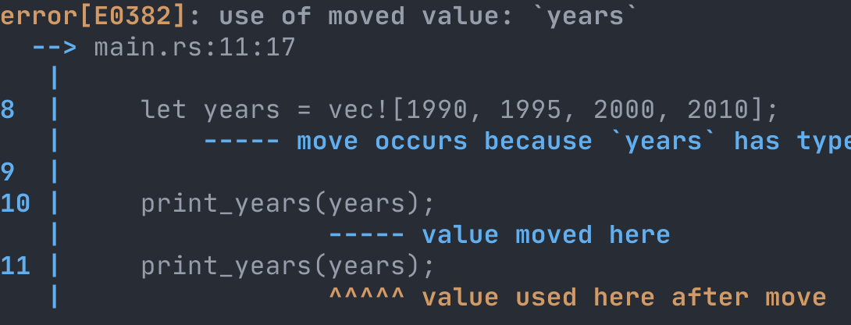
Use-after-move compiler error
fn print_years(years: Vec<i32>) { … }
fn main() {
let years = vec![1990, 1995, 2000, 2010];
print_years(years);
print_years(years); }

Slide 185
Use-after-move compiler error
fn print_years(years: Vec<i32>) {
for year in years.iter() {
println!("Year: {}", year);
} }
// dealloc(years)

Slide 186
Use-after-move compiler error
fn print_years(years: Vec<i32>) -> Vec<i32>{
for year in years.iter() {
println!("Year: {}", year);
}
return years; }
// transfer ownership
// to the caller’s scope
fn main() {
let years = vec![1990, 1995, 2000, 2010];
let years2 = print_years(years);
let years3 = print_years(years2); }
// dealloc(years3)

Slide 187
.clone() is your friend
fn print_years(years: Vec<i32>) {
for year in years.iter() {
println!("Year: {}", year);
} } // dealloc(years)
fn main() {
let years = vec![1990, 1995, 2000, 2010];
print_years(years);
print_years(years); }

Slide 188
.clone() is your friend
fn print_years(years: Vec<i32>) {
for year in years.iter() {
println!("Year: {}", year);
} } // dealloc(years)
fn main() {
let years = vec![1990, 1995, 2000, 2010];
print_years(years.clone());
print_years(years); }

Slide 189
Review of Part 5
manual dealloc(), use-after-free, double free
automatic GC pauses vs. Rust’s scope-based heuristics
ownership compiler errors prevent use-after-free
cloning addressing compiler errors by sacrificing perf

Slide 190
Exercises for Part 5
Follow the instructions in part5/README.md

Slide 191
6. Borrowing
References & Borrowing
Mutable References
Slices

Slide 192
References & Borrowing
fn print_years(years: Vec<i32>) {
for year in years.iter() {
println!("Year: {}", year);
} } // dealloc(years)
fn main() {
let years = vec![1990, 1995, 2000, 2010];
print_years(years); // compiler error
print_years(years); }

Slide 193
References & Borrowing
fn print_years(years: Vec<i32>) {
for year in years.iter() {
println!("Year: {}", year);
} }
fn main() {
let years = vec![1990, 1995, 2000, 2010];
print_years(years);
print_years(years); }

Slide 194
References & Borrowing
“a reference to a Vec<i32>”
fn print_years(years: &Vec<i32>) {
for year in years.iter() {
println!("Year: {}", year);
} }
“a reference to a self”
fn len(&self) -> usize
fn main() {
let years = vec![1990, 1995, 2000, 2010];
print_years(&years);
print_years(&years); }
temporarily give print_years access to years
(&years - “borrow years”)

Slide 195
Use-after-move compiler error
“borrow checker error”
You can’t “turn off the borrow checker” in Rust
an article by Rust Core Team member Steve Klabnik

Slide 196
Mutable References
let mut years: Vec<i32> = vec![1990, 1995];
let mutable_years: &mut Vec<i32> = &mut years;
mutable_years.clear();
// clear() removes all elements from the Vec
let length = mutable_years.len();
fn clear(&mut self) {
// set self's length to 0 }
fn len(&self) -> usize

Slide 197
Mutable Reference Restrictions
let years: Vec<i32> = vec![1990, 1995];
let years_ref1: &Vec<i32> = &years;
let years_ref2: &Vec<i32> = &years;

Slide 198
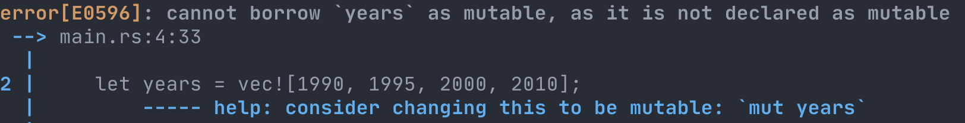
Mutable Reference Restrictions
let years: Vec<i32> = vec![1990, 1995];
let years2: &mut Vec<i32> = &mut years;

Slide 199
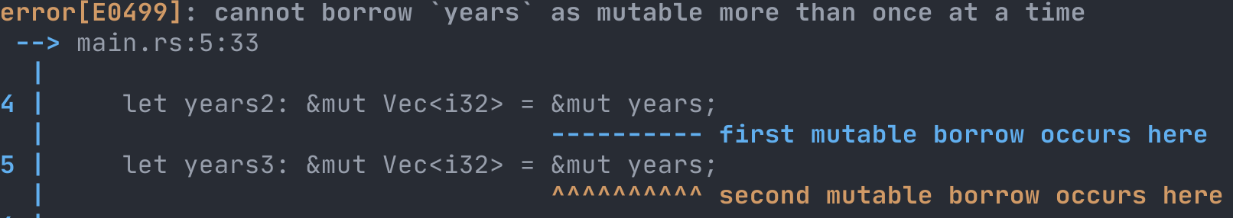
Mutable Reference Restrictions
let mut years: Vec<i32> = vec![1990, 1995];
let years2: &mut Vec<i32> = &mut years;
let years3: &mut Vec<i32> = &mut years;

Slide 200
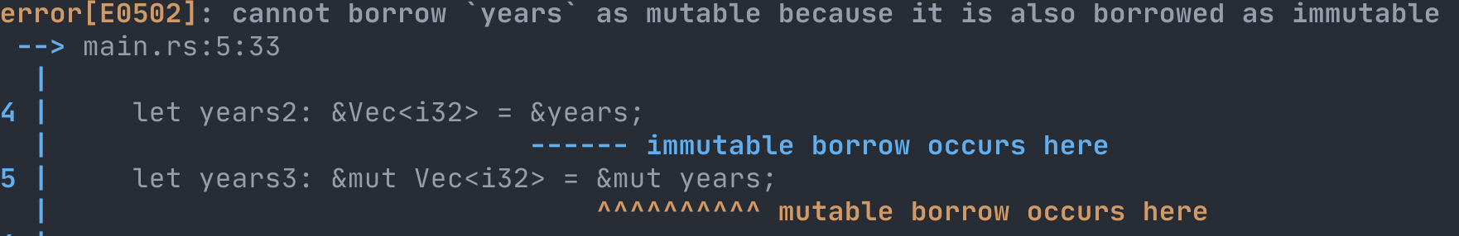
Mutable Reference Restrictions
let mut years: Vec<i32> = vec![1990, 1995];
let years2: &Vec<i32> = &years;
let years3: &mut Vec<i32> = &mut years;

Slide 201
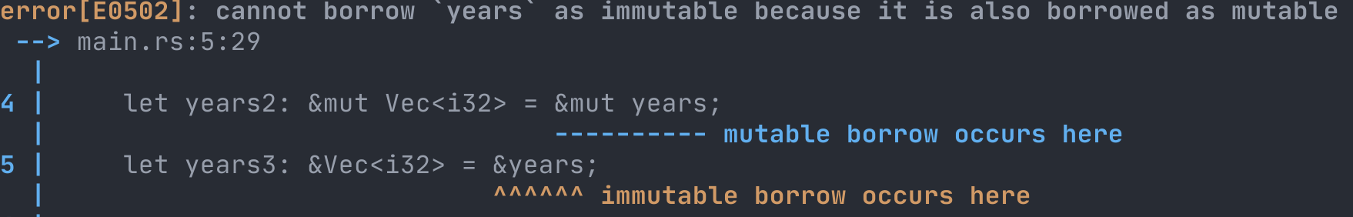
Mutable Reference Restrictions
let mut years: Vec<i32> = vec![1990, 1995];
let years2: &mut Vec<i32> = &mut years;
let years3: &Vec<i32> = &years;

Slide 202
Mutable Reference Restrictions
let years: Vec<i32> = vec![1990, 1995, 2005];
let mutable_years: &mut Vec<i32> = &mut years;
mutable_years.clear();
// clear() removes all elements from the Vec
fn clear(&mut self) {
// set self's length to 0 }
fn len(&self) -> usize

Slide 203
Slices
let nums = vec![1, 2, 3];
struct VecMetadata {
first_elem_index: usize,
length: usize,
capacity: usize, }

Slide 204
Slices
let nums = vec![1, 2, 3];
struct SliceMetadata {
first_elem_index: usize,
length: usize
}
let slice = &nums[0..2];
struct VecMetadata {
first_elem_index: usize,
length: usize,
capacity: usize, }
4
2
heap
4
171
1
2
3
4
4
…

Slide 205
Slices
let nums = vec![1, 2, 3];
struct SliceMetadata {
first_elem_index: usize,
length: usize
}
let slice = &nums[0..3];
2
3
nums: Vec<u8>
slice: &[u8]
slice doesn’t own
the elements, just
references them
heap
4
171
1
2
3
4
4
…

Slide 206
Slices
let str_slice = string[3..7];
nums: Vec<u8>
slice: &[u8]
slice doesn’t own
the elements, just
references them

Slide 207
Slices
let str_slice: &str = string[3..7];
nums: Vec<u8>
slice: &[u8]
slice doesn’t own
the elements, just
references them
nums.as_slice()
string.as_str()

Slide 208
Review of Part 6
borrowing let years_ref: &Vec<i32> = &years;
mut refs let x: &mut Vec<i32> = &mut years;
slices let slice: &[i32] = &years[1..3];
let foo: &str = &string[1..3];

Slide 209
Exercises for Part 6
Follow the instructions in part6/README.md

Slide 210
7. Lifetimes
Lifetimes
Lifetime Annotations
Lifetime Elision
The Static Lifetime

Slide 211
Lifetimes
let years: Vec<i64> = vec![ 1980, 1985, 1990, 1990, 2000, 2005, 2010 ];
let eighties: &[i64] = &years[0..2];
let nineties: &[i64] = &years[2..4];
println!( "We have {} years in the nineties", nineties.len() );

Slide 212
Lifetimes
fn jazz_releases(years: &[i64]) -> Releases {
let eighties: &[i64] = &years[0..2];
let nineties: &[i64] = &years[2..4];
Releases {
years,
eighties,
nineties,
}
}
struct Releases {
years: &[i64],
eighties: &[i64],
nineties: &[i64],
}

Slide 213
Lifetimes
fn jazz_releases(years: &[i64]) -> Releases {…}
let releases = {
let all_years: Vec<i64> = vec![ 1980, 1985, 1990, 1995, 2000, 2000 ];
jazz_releases(&all_years) };
struct Releases {
years: &[i64],
eighties: &[i64],
nineties: &[i64],
}
let eighties = releases.eighties;
use-after-free!

Slide 214
Lifetimes
fn jazz_releases(years: &[i64]) -> Releases {…}
let releases = {
let all_years: Vec<i64> = vec![ 1980, 1985, 1990, 1995, 2000, 2000 ];
jazz_releases(&all_years) }; // dealloc(all_years)
struct Releases {
years: &[i64],
eighties: &[i64],
nineties: &[i64],
}
slice of all_years.releases
let eighties = releases.eighties;
compiler
error!
use-after-free!

Slide 215
Lifetimes
the lifetime of all_years
let releases = {
let all_years: Vec<i64> = vec![ 1980, 1985, 1990, 1995, 2000, 2000 ];
jazz_releases(&all_years) }; // dealloc(all_years)
let eighties = releases.eighties;
refers to all_years after its lifetime has ended

Slide 216
Lifetimes
let releases = {
let all_years: Vec<i64> = vec![ 1980, 1985, 1990, 1995, 2000, 2000 ];
jazz_releases(&all_years) }; // dealloc(all_years)

Slide 217
Lifetimes
the lifetime of all_years
let releases = {
let all_years: Vec<i64> = vec![ 1980, 1985, 1990, 1995, 2000, 2000 ];
jazz_releases(&all_years) }; // dealloc(all_years)
let eighties = releases.eighties;
refers to all_years after its lifetime has ended

Slide 218
Lifetimes
fn jazz_releases(years: &[i64]) -> Releases {…}
let releases = {
let all_years: Vec<i64> = vec![ 1980, 1985, 1990, 1995, 2000, 2000 ];
jazz_releases(&all_years) }; // dealloc(all_years)
let eighties = releases.eighties;
refers to all_years after its lifetime has ended

Slide 219
Lifetimes
still within its lifetime
fn jazz_releases(years: &[i64]) -> Releases {…}
Releases depends on years
let releases = {
let all_years: Vec<i64> = vec![ 1980, 1985, 1990, 1995, 2000, 2000 ];
jazz_releases(&all_years) }; // dealloc(all_years)
let eighties = releases.eighties;
refers to all_years after its lifetime has ended

Slide 220
Lifetimes
fn jazz(years: &[i64]) -> Releases {
let eighties: &[i64] = &years[0..2];
let nineties: &[i64] = &years[2..4];
Releases {
years,
eighties,
nineties,
}
}
struct Releases {
years: &[i64],
eighties: &[i64],
nineties: &[i64],
}

Slide 221
Lifetimes
a lifetime parameter named 'a
fn jazz<'a>(years: &'a [i64]) -> Releases {
let eighties: &[i64] = &years[0..2];
let nineties: &[i64] = &years[2..4];
Releases {
years,
eighties,
nineties,
}
}
struct Releases {
years: &[i64],
eighties: &[i64],
nineties: &[i64],
}

Slide 222
Lifetimes
a lifetime parameter named 'a
fn jazz<'a>(years: &'a [i64]) -> Releases {
let eighties: &'a [i64] = &years[0..2];
let nineties: &'a [i64] = &years[2..4];
Releases {
years,
eighties,
nineties,
}
}
struct Releases {
years: &[i64],
eighties: &[i64],
nineties: &[i64],
}

Slide 223
Lifetimes
a lifetime parameter named 'a
fn jazz<'a>(years: &'a [i64]) -> Releases {
let eighties: &'a [i64] = &years[0..2];
let nineties: &'a [i64] = &years[2..4];
Releases {
years,
eighties,
nineties,
}
}
struct Releases<'y> {
years: &'y [i64],
eighties: &'y [i64],
nineties: &'y [i64],
}
a lifetime parameter named 'y

Slide 224
Lifetimes
fn jazz<'a>(years: &'a [i64]) -> Releases<'a>
the lifetime of all_years
let releases = {
let all_years: Vec<i64> = vec![ 1980, 1985, 1990, 1995, 2000, 2000 ];
jazz(&all_years) }; // dealloc(all_years)
let eighties = releases.eighties;
refers to all_years after its lifetime has ended

Slide 225
Lifetimes
fn jazz<'a>(years: &'a [i64]) -> Releases<'a>
let releases: Releases<'a> = {
let all_years: Vec<i64> = vec![ 1980, 1985, 1990, 1995, 2000, 2000 ];
jazz(&all_years) }; // dealloc(all_years)
let eighties = releases.eighties;
refers to Releases<'a> after 'a has ended

Slide 226
Lifetimes
fn jazz<'a>(years: &'a [i64]) -> Releases<'a>
let releases: Releases<'a> = {
let all_years: Vec<i64> = vec![ 1980, 1985, 1990, 1995, 2000, 2000 ];
jazz(&all_years) };
struct Releases<'y> {
years: &'y [i64],
eighties: &'y [i64],
nineties: &'y [i64],
}
lifetime annotations are required in all structs that hold references

Slide 227
Lifetime Elision
fn jazz<'a>(years: &'a [i64]) -> Releases<'a>
let releases: Releases<'a> = {
let all_years: Vec<i64> = vec![ 1980, 1985, 1990, 1995, 2000, 2000 ];
jazz(&all_years) };

Slide 228
Lifetime Elision
fn jazz<'a>(years: &'a [i64]) -> Releases<'a>
let releases: Releases<'_> = {
let all_years: Vec<i64> = vec![ 1980, 1985, 1990, 1995, 2000, 2000 ];
jazz(&all_years) };

Slide 229
The Static Lifetime
let name = "Sam";
let name: &'static str = "Sam";
let name: &str = "Sam";

Slide 230
Review of Part 7
lifetimes time between a value is allocated and deallocated
annotations struct Foo<'a> { x: &'a [i64] }
elision fn len<'a>(&'a self) ⇒ fn len (&self)
&'static let hi: &'static str = "Hello, World!"

Slide 231
Exercises for Part 7
Follow the instructions in part7/README.md

Slide 232
Wrap-Up
Summary
Additional Resources

Slide 233
rust-lang.org
“ A language empowering everyone to build reliable and efficient software.”

Slide 234
machine code
0111010110101100111101101101011001001011
Rust
compiles to either
Notes:
Elm is a functional programming language that compiles to JavaScript.

Slide 235
Who uses Rust?
More at rust-lang.org/production
Notes:
So this is a different language with different syntax...what's the benefit? Or, in more tangible terms: why should my boss let me use this at work? On the nontechnical side, there are more people who want an Elm job than there are Elm jobs. But let's talk technical benefits: first with a specific example, then looking at the big picture.

Slide 236
Why use Rust?
Speed
Performance
Going Real Fast
Notes:
So this is a different language with different syntax...what's the benefit? Or, in more tangible terms: why should my boss let me use this at work? On the nontechnical side, there are more people who want an Elm job than there are Elm jobs. But let's talk technical benefits: first with a specific example, then looking at the big picture.

Slide 237
1. Primitives
strings format!("Hi, {}!", name)
floats let mut float: f64 = 1.234;
integers let one: u32 = 1.99 as u32;
booleans if x > 5 { true } else { false }

Slide 238
2. Collections
tuples let foo: (i64, bool) = (1, true);
structs struct Foo { x: i64, is_up: bool }
arrays let arr: [u32; 3] = [1, 2, 3];
memory u8 is 8 bits (1 byte), u16 is 16 bits (2 bytes), …

Slide 239
3. Pattern Matching
enums let purple = Color::Custom(1, 2, 3);
matching match color { Color::Custom(r, g, b) => { r + g + b } }
methods color.rgb() == Color::rgb(color)
type params let first: Option<char> = str.pop();

Slide 240
4. Vectors
Vec let nums: Vec<u8> = vec![1, 2];
usize u64 on 64-bit systems, u32 on 32-bit
stack memory stack_bytes[stack_length - 1]
heap memory heap_bytes[index_of_first_elem]

Slide 241
5. Ownership
manual dealloc(), use-after-free, double free
automatic GC pauses vs. Rust’s scope-based heuristics
ownership compiler errors prevent use-after-free
cloning addressing compiler errors by sacrificing perf

Slide 242
6. Borrowing
borrowing let years_ref: &Vec<i32> = &years;
mut refs let x: &mut Vec<i32> = &mut years;
slices let slice: &[i32] = &years[1..3];
let foo: &str = &string[1..3];

Slide 243
7. Lifetimes
lifetimes time between a value is allocated and deallocated
annotations struct Foo<'a> { x: &'a [i64] }
elision fn len<'a>(&'a self) ⇒ fn len (&self)
&'static let hi: &'static str = "Hello, World!"

Slide 244
Additional Resources
rust-lang.org/learn
rust-lang.org/community
rust-analyzer.github.io (LSP extension)
The lessons/ directory in this workshop’s repo

Slide 245


@rtfeldman

